Slide 1
Flyzy Flight Analysis
By : Vijay Dor

Slide 2
Factors Affecting Flight Ticket Prices
Introduction
The price of airline tickets is determined by various factors such as flight duration, days left for departure, arrival time, departure time, demand, competition, and operating costs. Airlines use sophisticated algorithms and pricing strategies to optimize their revenue and profitability while also meeting the demands of customers and the competitive landscape. By considering these factors, airlines can set ticket prices accordingly and maximize their revenue.
Welcome to the presentation on the Factors Affecting Flight Ticket Prices.
Understanding the factors that affect ticket prices is crucial for travelers to make informed decisions and save money.
In this presentation, we will discuss the key factors that affect flight ticket prices and offer recommendations for travelers to save money on their flights.
Let's dive into the analysis and explore the insights!

Slide 3
Data Analysis
Project Brief
The price of an Airline Ticket is affected by a number of factors, such as flight duration, days left for departure, arrival time and departure time etc. Airline organizations may diminish the cost at the time they need to build the market and at the time when the tickets are less accessible. They may maximize the costs. The price may rely upon different factors. Each factor has its own proprietary rules and algorithms to set the price accordingly.
Connecting data source and cleaning data
Power BI analysis of Flyzy flight analysis! I have taken the first step of acquiring the data and performed some basic data cleaning by removing an unnecessary index column from the dataset.
Creating measures in Power BI is an important step in data analysis, by calculating the average duration and price, we can gain insights into the typical flight duration and pricing trends of Flyzy flights.
Overall, by performing basic data cleaning and aggregation.

Slide 4
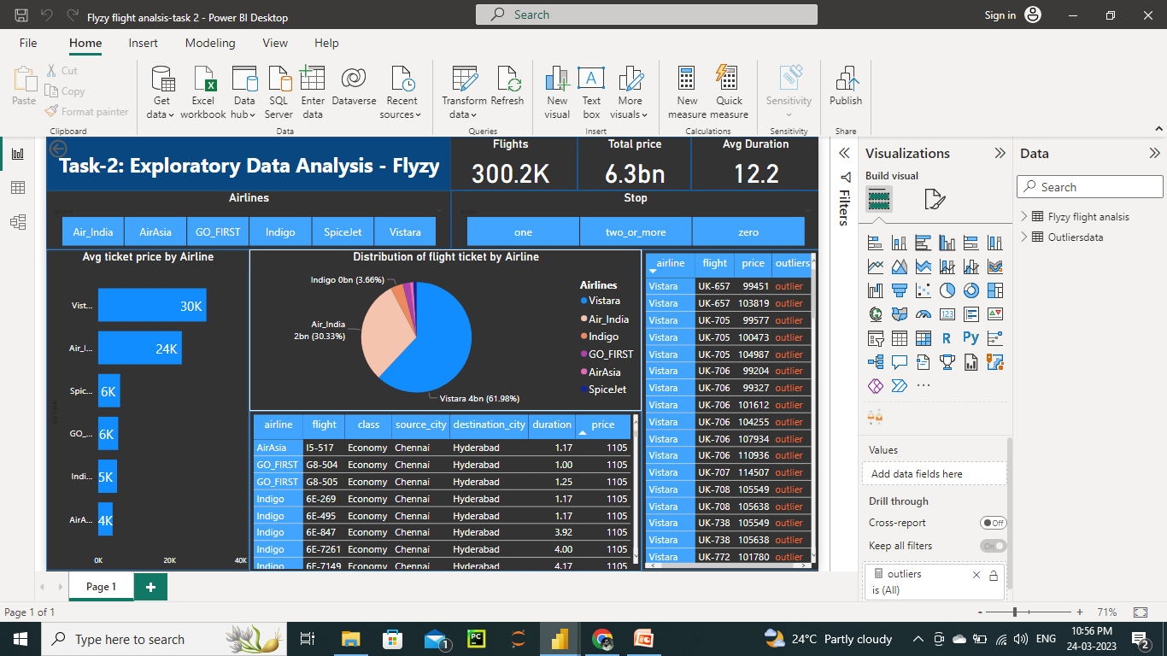
Exploratory data analysis
I have taken the first step of getting the data into Power Bi and performed some basic cleaning by removing an unnecessary index column from the dataset.
Create a new table for the detection of outliers and create a relation between both tables.
creating measures in Power Bi is an important step in data analysis, by calculating the outliers we can get insights into the typical flights and pricing trends of Flyzy flights.
Identifying patterns, trends, and relationships between variable
Find distribution of flight ticket and average flight ticket by airlines.

Slide 5
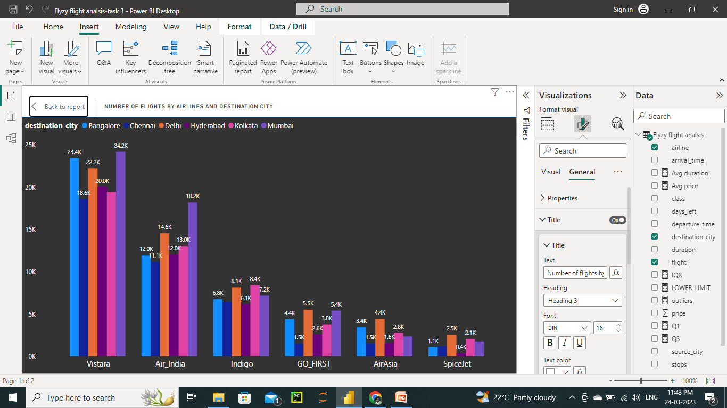
Data insights and visualizations
Number of flight by airlines and destination city:
The destination and flight route also affect ticket prices. Flights to popular destinations, such as Mumbai, Delhi, or Bangalore, are typically more expensive than flights to less popular destinations. Similarly, direct flights are generally more expensive than connecting flights.

Slide 6
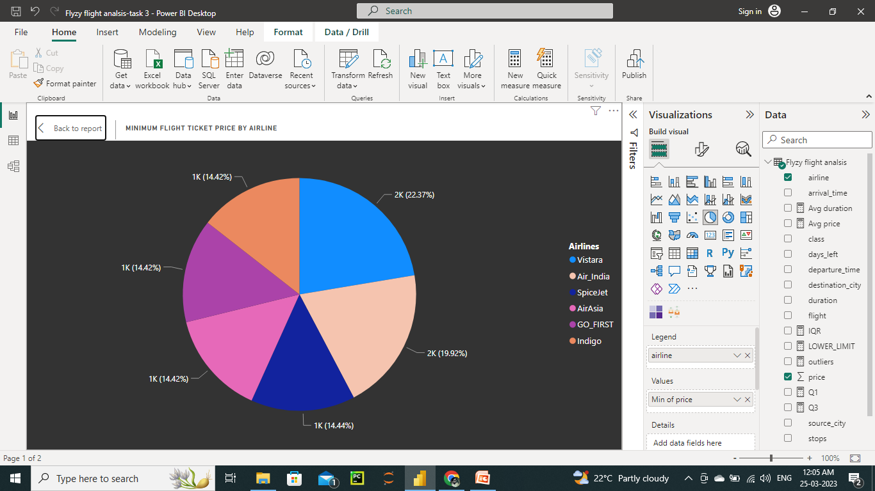
Data insights and visualizations
Minimum flight ticket price by airline:
The pie chart below shows the minimum flight ticket price for each airline for a one-way ticket.
The data shows that Indigo offers the lowest minimum ticket price, at 1K. Air Asia and Go-First Airlines also offer relatively low minimum prices, at 1K and 1K respectively.
It is important to note that these are minimum prices and actual ticket prices may vary depending on various factors such as the days left, time of travel, advance booking, and availability.
Travelers can use this data to compare prices between airlines and find the best deals to save money on their flights.

Slide 7
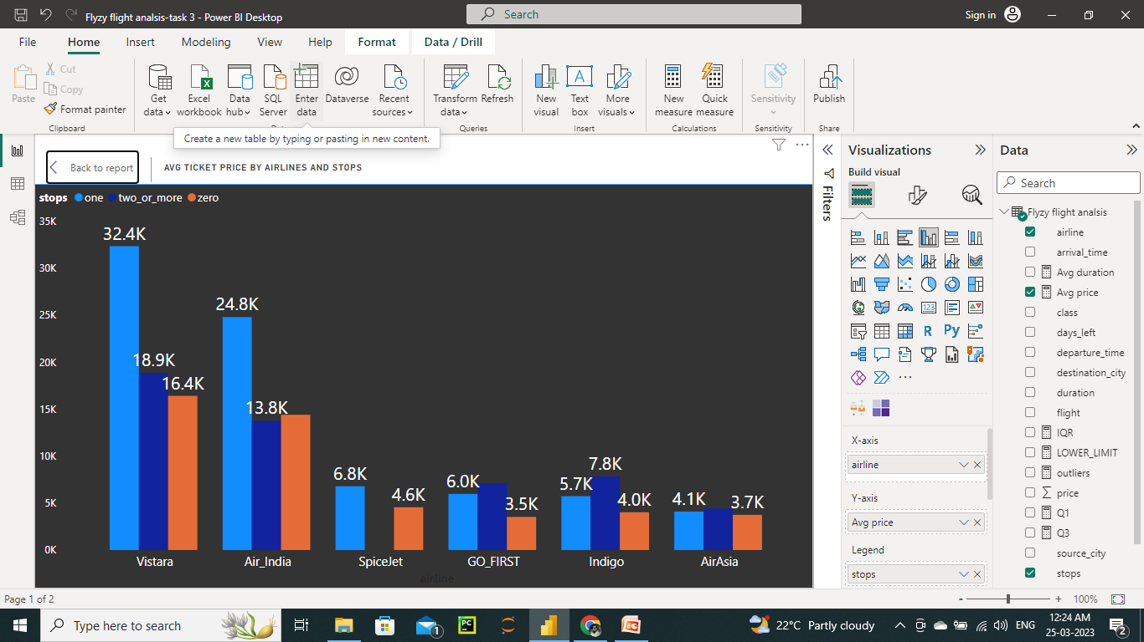
Data insights and visualizations
Average Flight Ticket Price by Airline and Stops:
The chart below shows the average flight ticket price for each airline, segmented by the number of stops
The data shows that Go-First offers the lowest average ticket price for direct flights,3.5K, followed by Air Asia, Indigo, and Spice jet.
It is important to note that these are average prices and actual ticket prices may vary depending on various factors such as the days left, time of travel, advance booking, and availability.
Travelers can use this data to compare prices between airlines and different numbers of stops to find the best deals and save money on their flights.

Slide 8
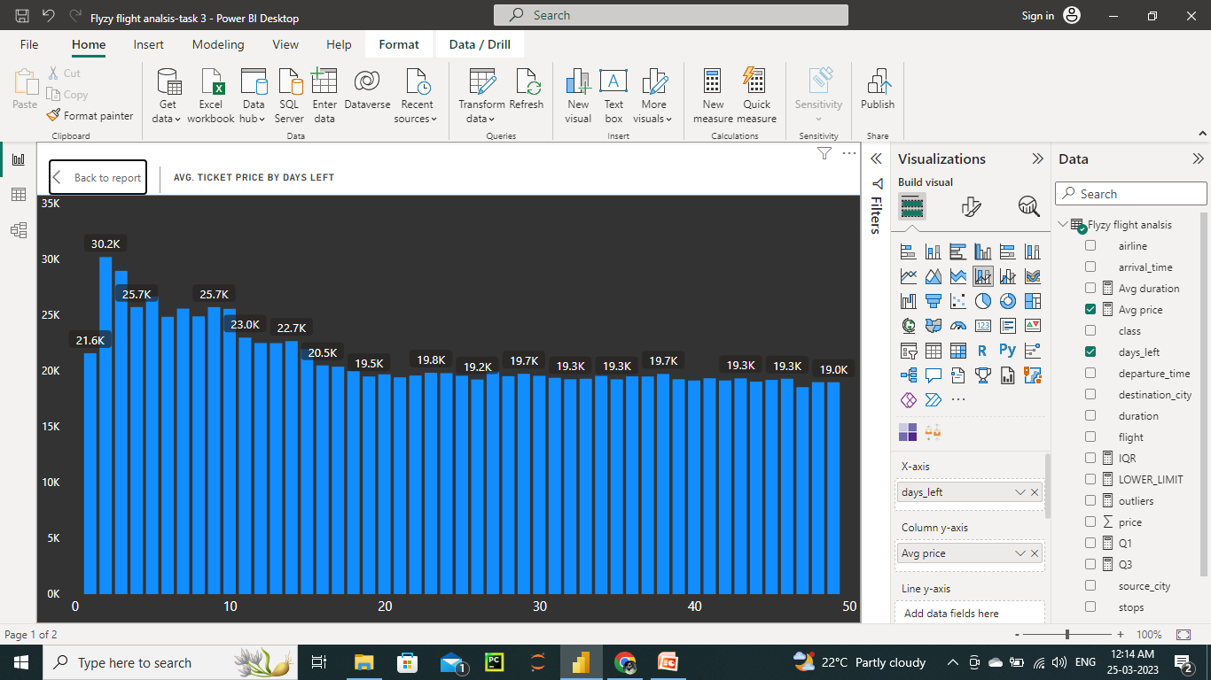
Data insights and visualizations
Average Flight Ticket Price by Days Left:
The graph below shows the average flight ticket price for a one-way ticket.
The data shows that ticket prices tend to be relatively stable in the days leading up to the departure day, but start to increase rapidly in the final days before the departure.
The best time to book flights for this route is between 40 and 50 days before the departure date, when prices are typically at their lowest.
It is important to note that these are average prices and actual ticket prices may vary depending on various factors such as the days left, time of travel, advance booking, and availability.
Travelers can use this data to compare prices between airlines and different numbers of stops to find the best deals and save money on their flights.

Slide 9
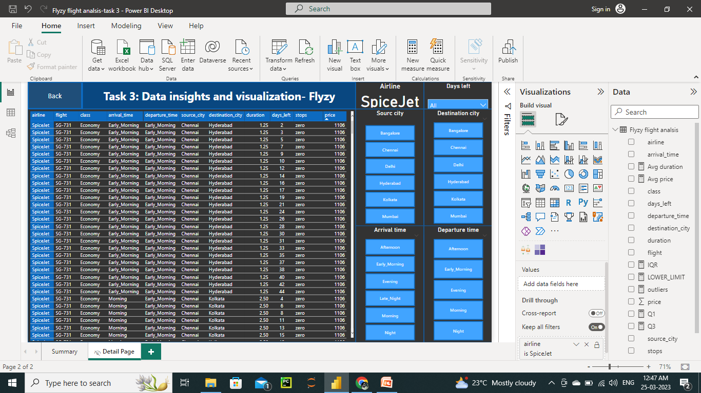
Data insights and visualizations
Drill through page:
The graph below shows the drill through page that breaks down the ticket price by airlines, with columns for the number of days left until departure, source city, destination city, stops, and any other relevant details, such as the airline or type of ticket.
Include filters or interactive elements that allow stakeholders to adjust the data based on their specific needs or preferences, such as filtering by airline or departure time.

Slide 10
Conclusion
Analyzing the factors that impact airline ticket prices is crucial for airlines to remain competitive in the market. By understanding how flight duration, days left for departure, arrival and departure time, competition, seasonality, ancillary fees, and supply and demand affect ticket prices, airlines can make informed decisions about how to price their tickets to attract customers and maximize revenue. The insights gained from data analysis can help airlines develop pricing strategies that are tailored to their specific market conditions, which in turn can lead to improved profitability and customer satisfaction. By leveraging the power of data, airlines can stay ahead of the competition and provide the best possible value to their customers.

Slide 11
Thank You

